Slide 1

Analyzing the Effect of Macro-Economic Variables and Commodity Market on S&P500 Index
Khem Raj Bhatt

Slide 2

Most traders and investors in equity market of United States have an opinion in common that fluctuation in equity market is due to economic variables. So, in this analysis I have analyzed the fluctuation in S&P500 index by macro-economic variables and commodity market variables.
If we talk about financial market in US, there are different types:
Introduction
01
Capital Market (Equity market which is also referred as secondary market)
02
Bond market
03
Commodity market
04
FOREX
05
Over the counter (OTC)

Slide 3

Why the secondary market or equity market is a crucial indicator of an economy?
01
It is a good indicator of a country’s economic condition.
02
Also, it is the basis of primary market which is the foundation of development and growth.
Out of all these types of financial market, the most popular one in the US is the equity market or stock market. However, analyzing the equity market we must be clear that we have three different popular indexes:
The NASDAQ composite index
Dow Jones
S&P 500
More reflects about Industries
Based on 11 sectors classified based on GICS which makes it represent more diverse set of companies
More reflects about technological companies So, finally we decided taking S&P500 index.

Slide 4

Research Methodology
I shall be creating a panel data taking quarterly data from 2018 to current time. I tried compiling together quarterly data to analyze the relation between the variables and tried to analyze breaking down the entire data set based on pre-covid (between 2018-01-01 to 2019-10-30), during covid (between 2019-11-01 to 2022-04-01) and post covid (post 2022-04-01). All the data are obtained from Federal Reserve Economic Data|FRED|St.Louis Fed.

Slide 5
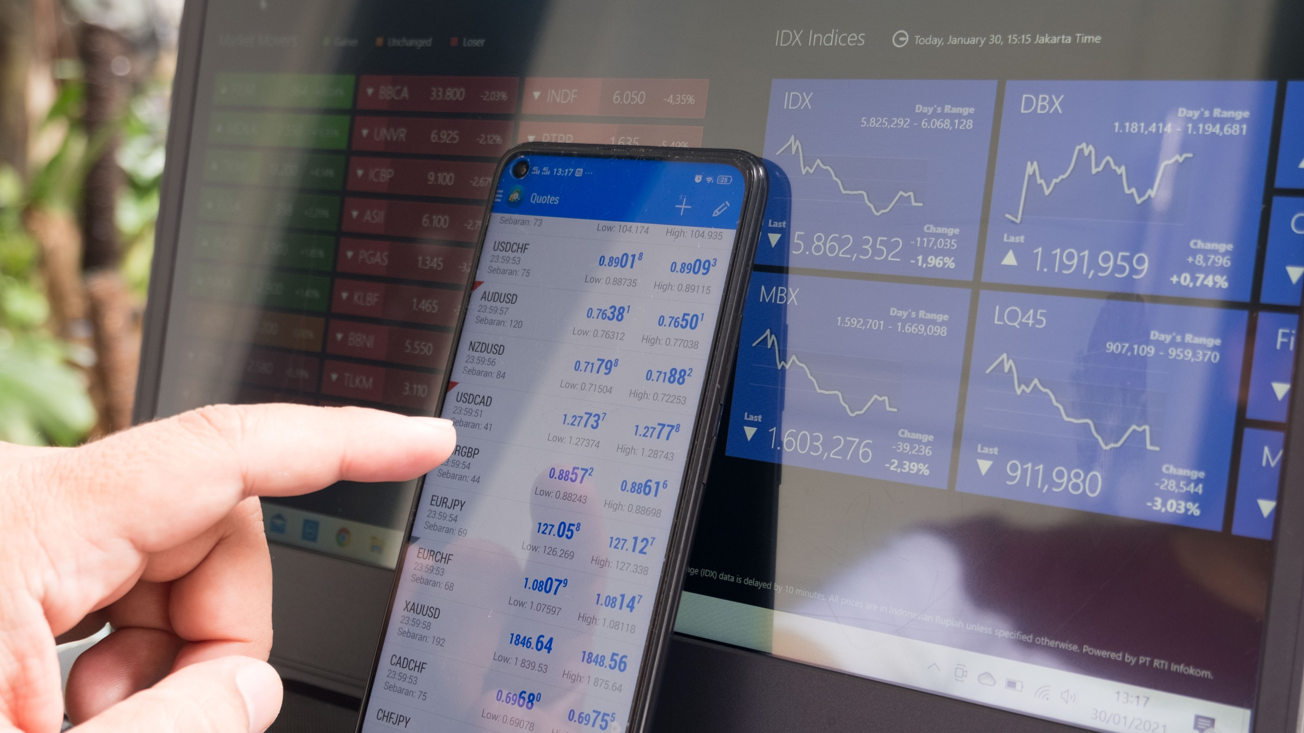
Is volatility in S&P 500 be explained using macroeconomic variable and commodity market variables?
Explained Variable: S&P 500 index
Research Question
Explanatory Variables: Key macro-economic variables- Real disposable per capita income (PCI), consumer price index (CPI), producer’s price index (PPI), real GDP, interest rate and unemployment rate
Key commodity market variables- Gold price index, and crude oil price per gallon.

Slide 6


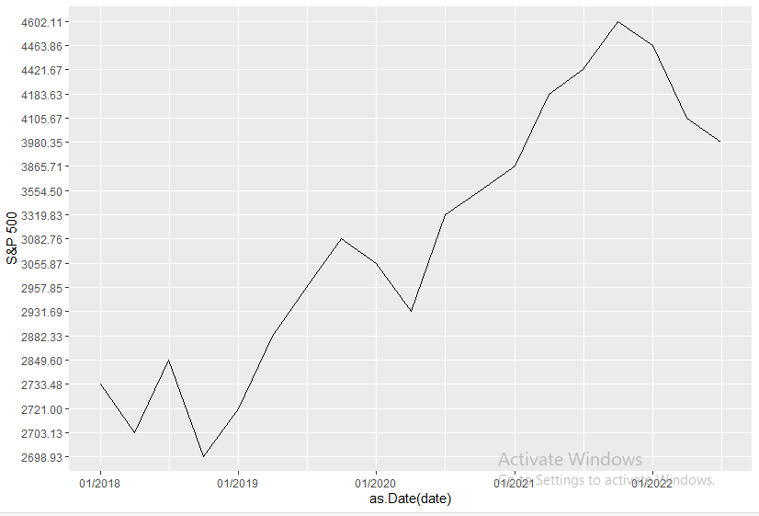
S&P 500

Slide 7
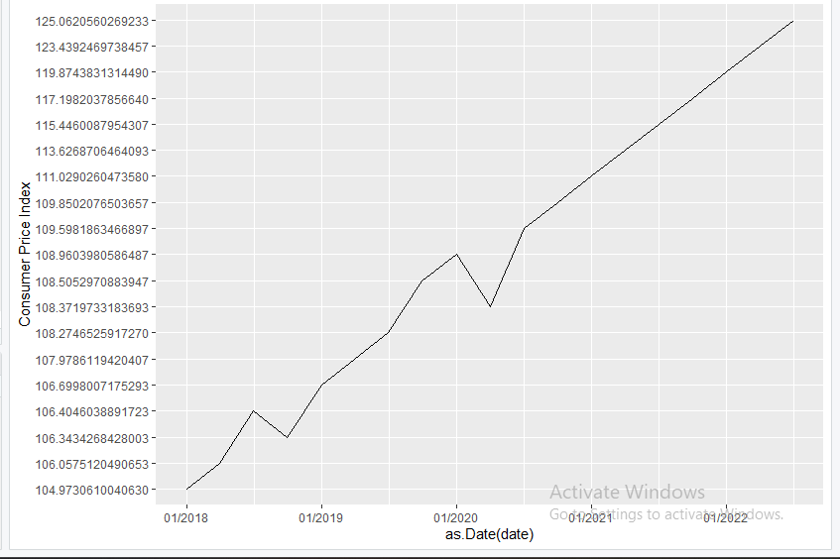
Consumer Price Index

Slide 8
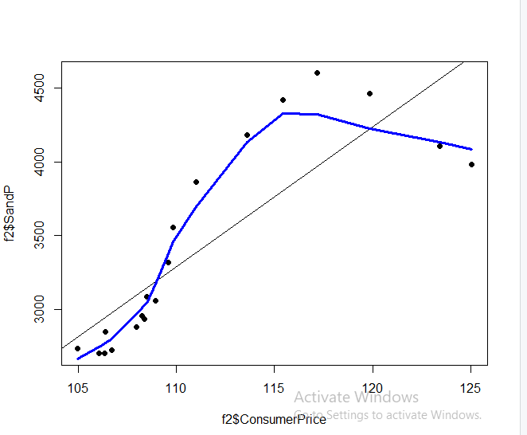
Correlation between S&P 500 and Consumer Price

Slide 9
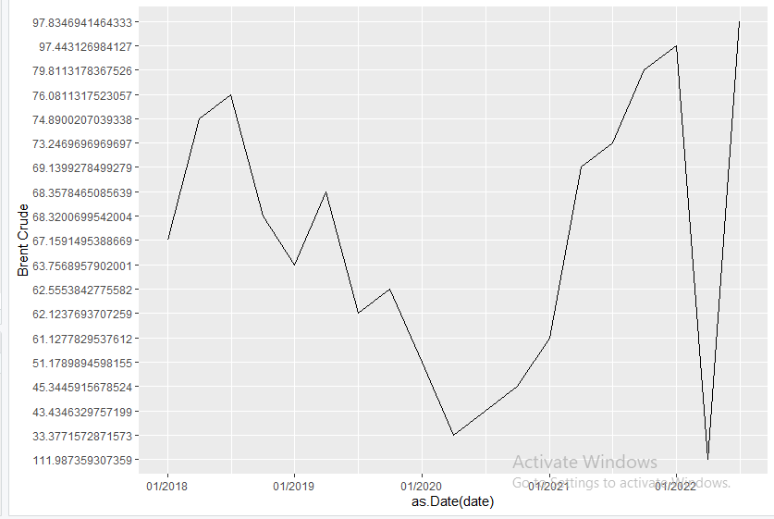
Crude Oil

Slide 10
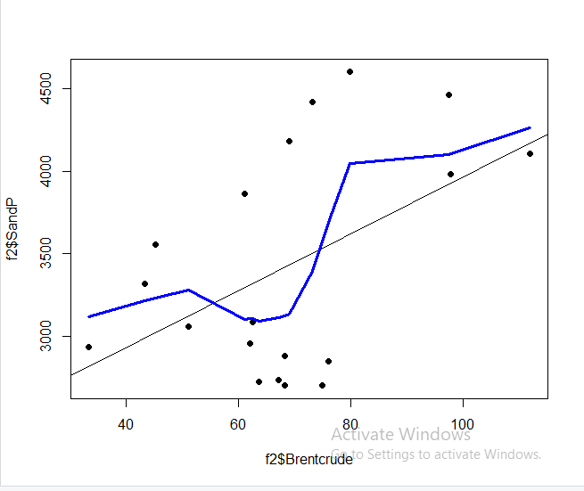
Correlation between S&P 500 and Crude Oil

Slide 11
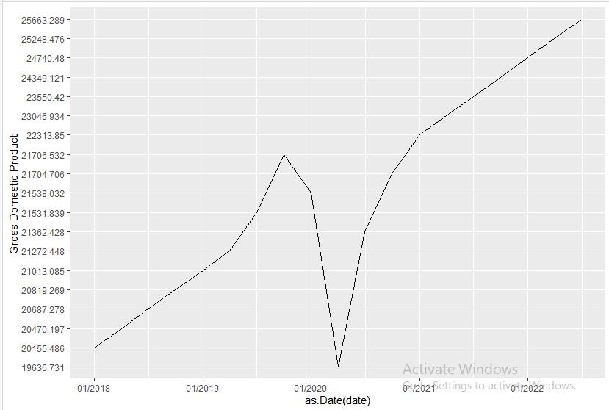
Gross Domestic Product

Slide 12
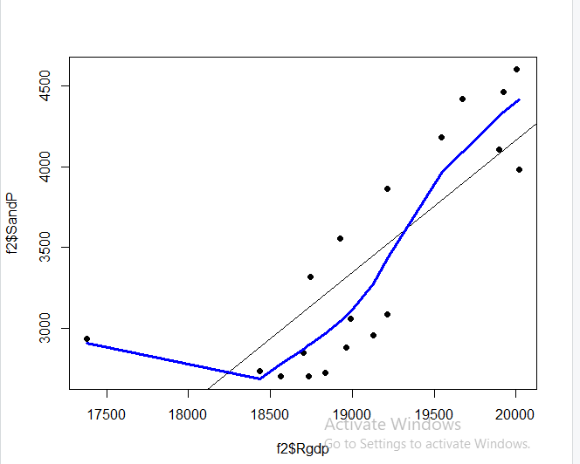
Correlation between S&P 500 and RGDP

Slide 13
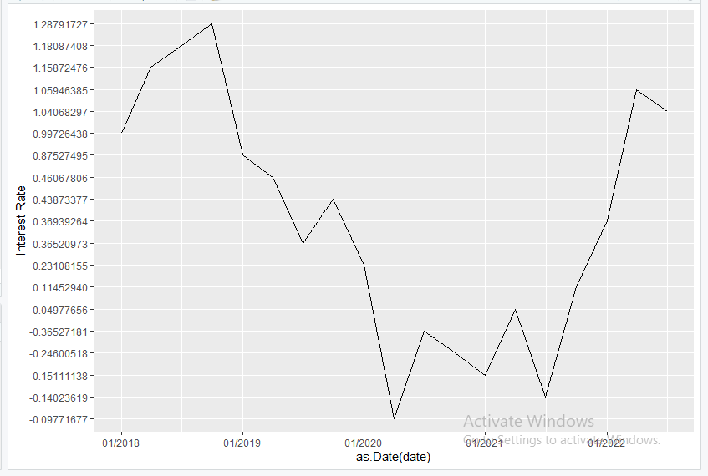
Interest Rate

Slide 14
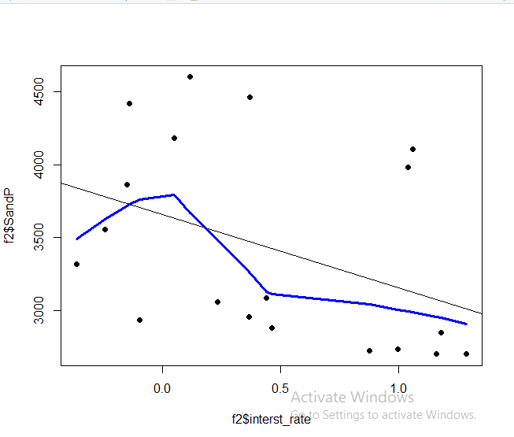
Correlation between S&P 500 and Interest Rate

Slide 15
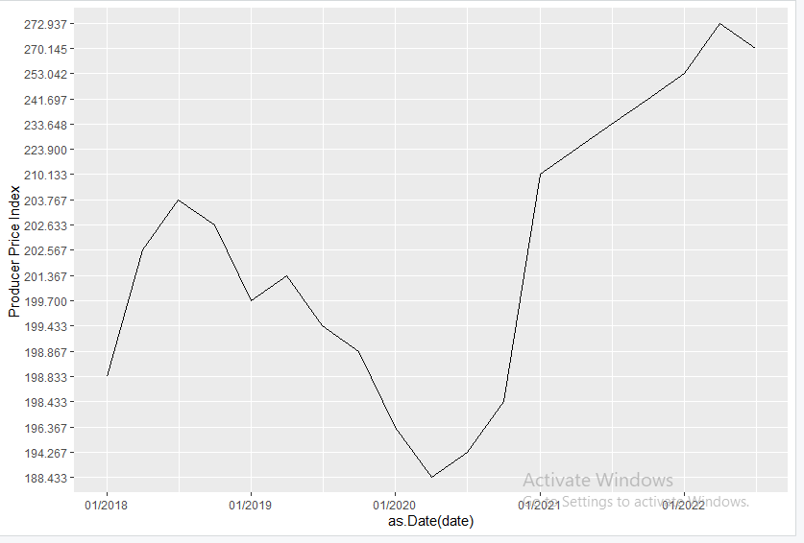
Producer Price Index

Slide 16
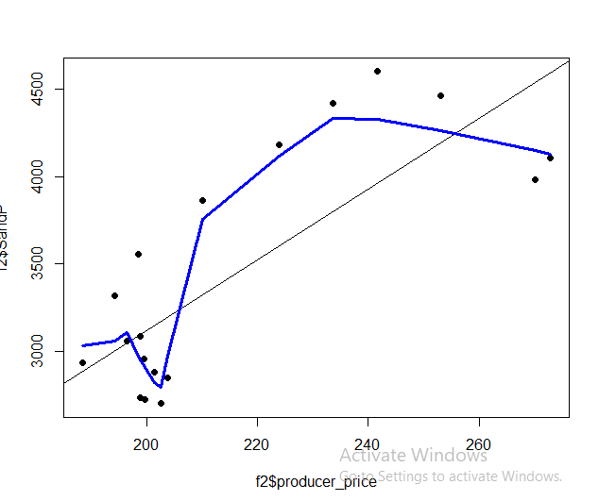
Correlation between S&P 500 and Producer Price

Slide 17
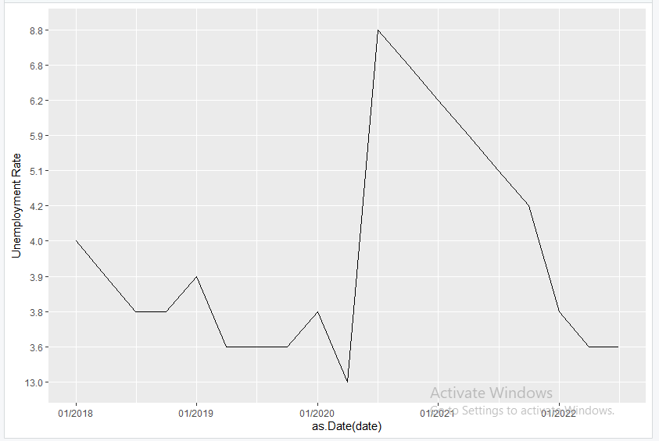
Unemployment Rate

Slide 18
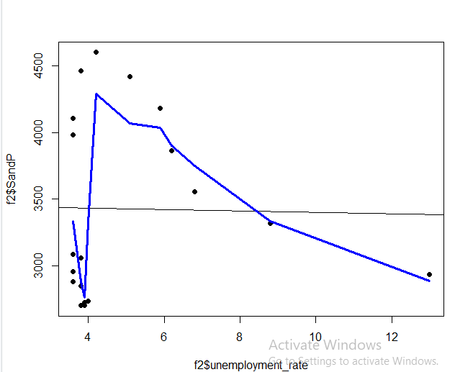
Correlation between S&P 500 and Unemployment Rate

Slide 19
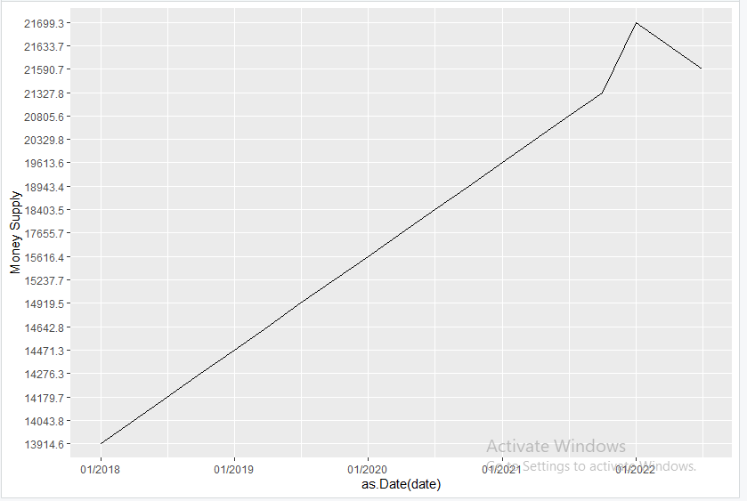
Money Supply

Slide 20
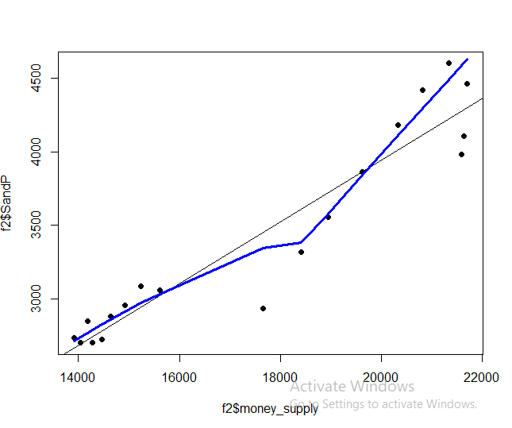
Correlation between S&P 500 and Money Supply

Slide 21
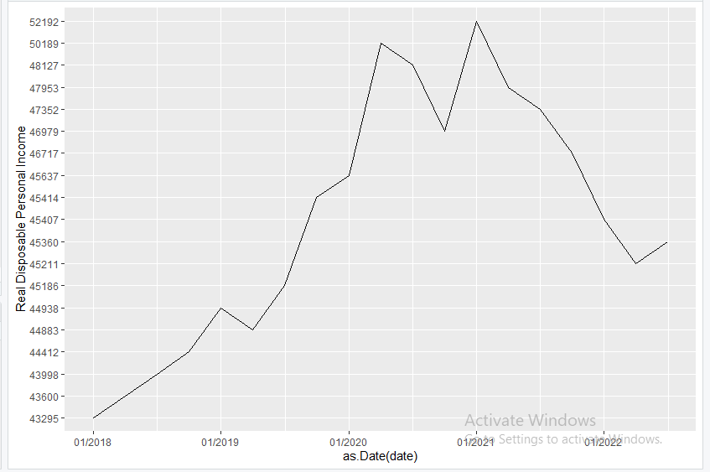
Real Disposable Per Capita Income

Slide 22
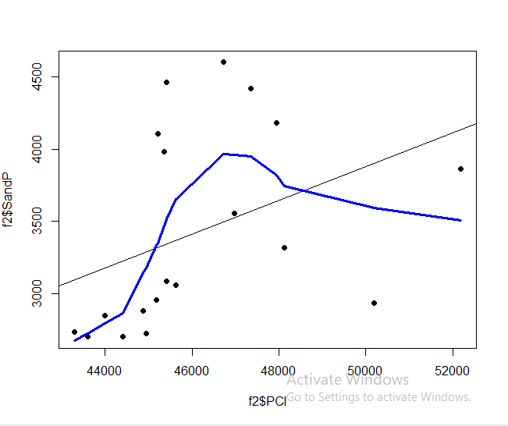
Correlation between S&P 500 and RDPCI

Slide 23
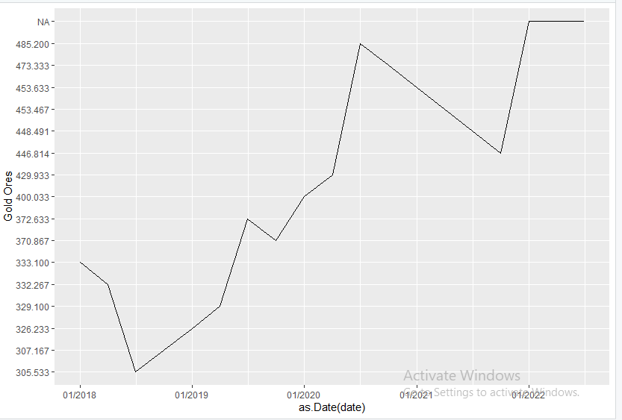
Gold Price

Slide 24
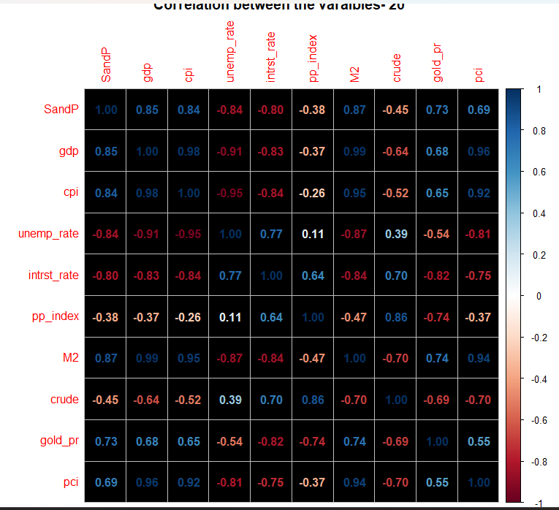
Correlation Before Covid

Slide 25
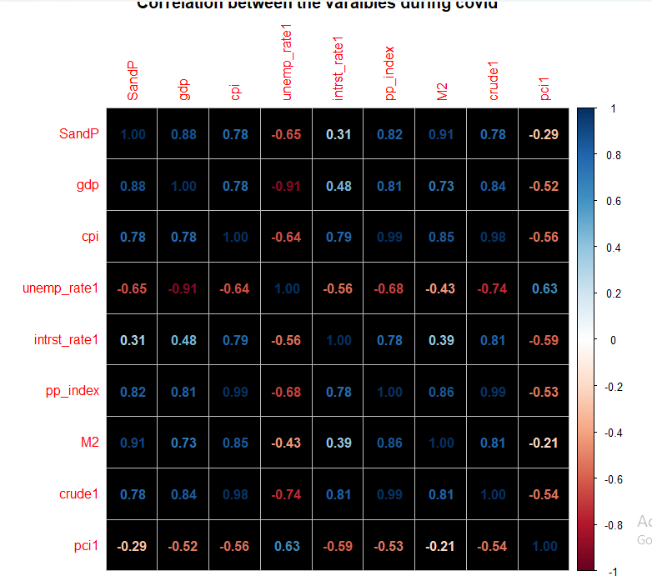
Correlation During Covid

Slide 26
Conclusion

Slide 27

THANK YOU

